Slide 1

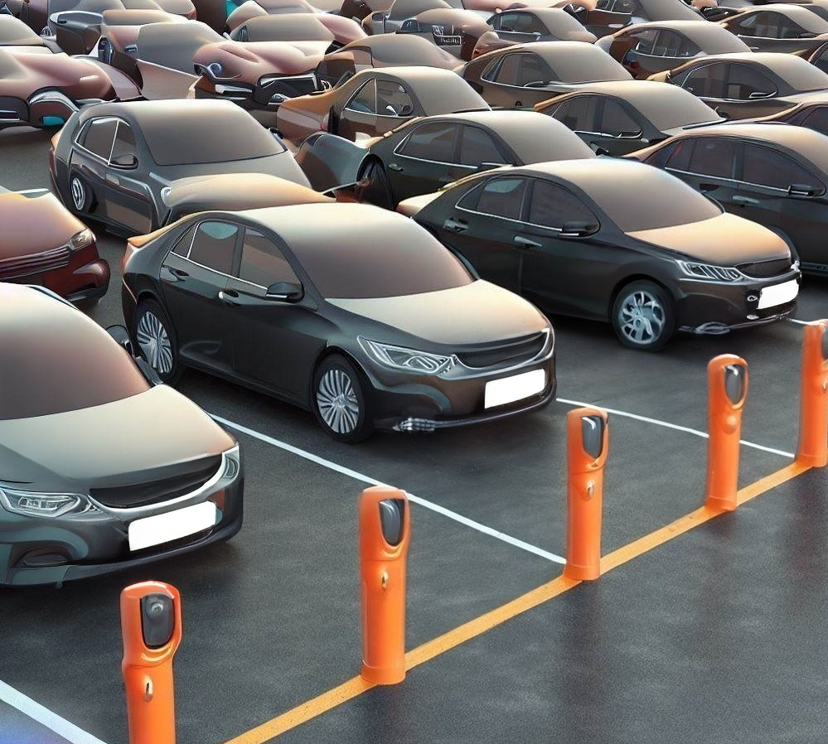
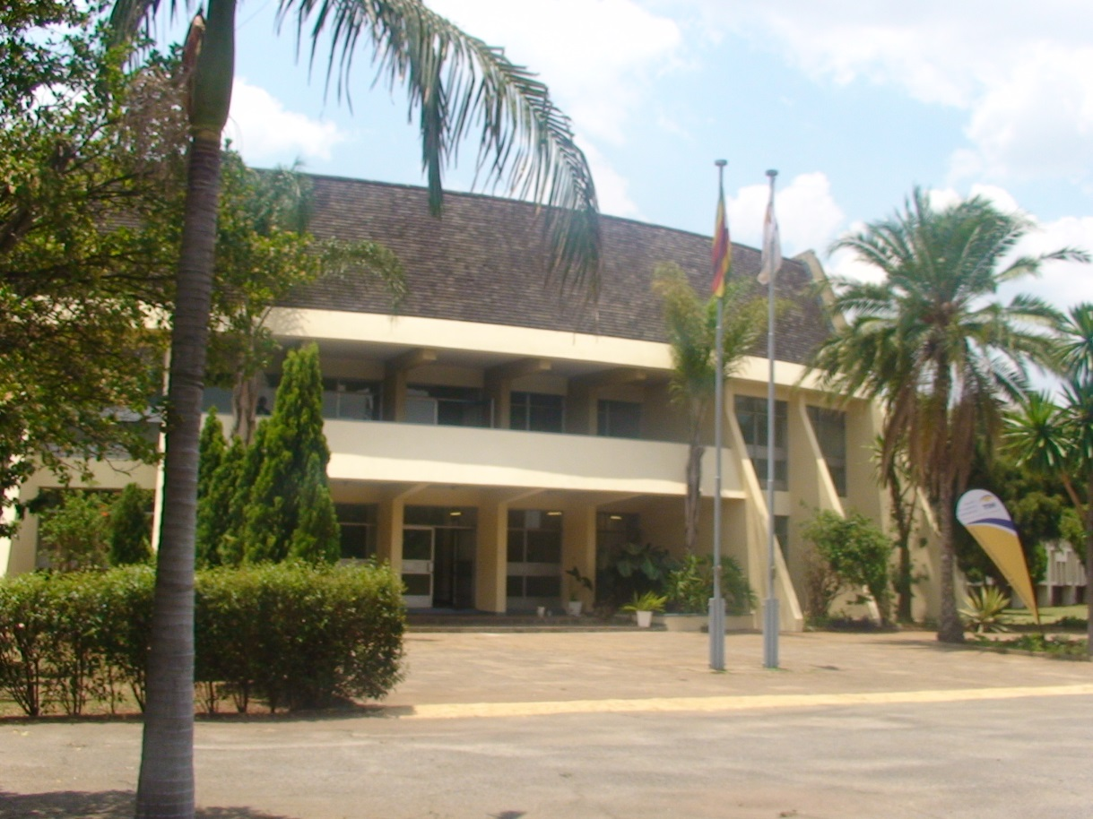
Autonomous Parking Bay
Detection System
Central Database
Park Pay
Reporting System
is a camera-based system that uses computer vision and licence plate recognition AI models to detect the number plates of parked vehicles and measure the parking duration. It communicates with the database to query and update the customer account information and the parking cost based on the number plate and the duration.
is a centralized storage system that maintains the customer account information, such as the number plate, the transaction history, and the payment status. It also records the car service information, such as the parking bay, the arrival time, and the departure time, and the fee information, such as the parking duration and the parking cost.
is an online payment system that allows customers to pay for their parking using a third-party payment platform that is integrated with the system. It enables customers to log in using their number plate as an identifier and view their transaction history. It also confirms the payment and updates the payment status in the database
is a reporting system that generates reports of the parking activity for monitoring and analysis. It retrieves the car service and fee information from the database and displays it on a dashboard. It can also provide statistics and insights on the parking usage, revenue, and customer behavior.
xxxxxxxxxxxxxxxxxxxxxxxxxxxxxxxxxxxxxxxxxxxxxxxxxxxxxxxxxxxxxxxxxxxxxxxxxxxxxxxxxxxxxxxxxxxxxxxxxxxxxxxxxxxxxxxxxxxxxxxxxxxxxxxxxxxxxxxxxxxxxxxxxxxxxxxx
These should be succinct and be derived from findings or conclusions. If recommendations are targeted at policy makers or stakeholders then they should be unambiguous and clear.
Xxxxxxxxxxxxxxxxxxx
Xxxxxxxxxxxxxxxxxxxxxxxxxxxxxxxxxxxxxxxxxxxxxxxxxxxxxxxxxxxxxxxxxxxxxxxxxxxxxxxxxxxxxxxxxxxxxxxxxxxxxxxxxxxxxxxxxxxxxxxxxxxxxxxxxxxxxxxxxxxx
References
2021
All references used as sources of information in your research paper should be mentioned to strengthen your paper and also to avoid your work being considered plagiarized.
HIT Info

